Slide 1
Formal Verification of RL-based Approaches

Slide 2
Why Verification / Motivation
Overview Formal Verification (Model Checking, SMT, LTL, …)
SMT Example
Use Case
Challenges
Different Types of Verification + Example
Neural Networks Verification?
(Safe RL)
Paper1, Paper2, …
Open Questions
Problems
Own Thoughts / Opinion

Slide 3
Topics
Our Introduction
Why Formal Verification, Problems in RL, Motivation, Our Research Questions
Introduction to Formal Verification
Model Checking
What can be verified in RL?
Offline Verification
Neural Networks, Reluplex, …
Online/Runtime Verification
ModelPlex Paper, …
Open Questions and Problems
Opinion, …

Slide 4
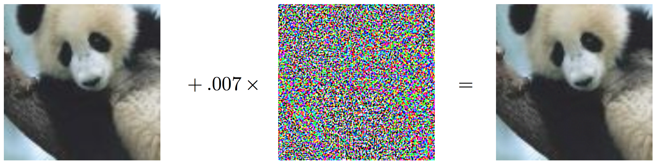
We cannot use “confidence” as safety measure
“panda” 57.7% confidence
“gibbon” 99.3% confidence
Notes:
https://arxiv.org/pdf/1412.6572.pdf (2015)

Slide 5
Adversarial Examples in the Real World

Slide 6
And we need a method to detect abnormal situations

Slide 7
https://www.youtube.com/watch?v=_CdJ4oae8f4
“Self-Driving Uber running red light”

Slide 8
How can we ensure that our machine works well in these situations?

Slide 9
Why Formal Verification?

Slide 10
Testing does not suffice
Testing does not suffice
“Program testing can be a very effective way to show the presence of bugs, but is hopelessly inadequate for showing their absence.“
Who said that?

Slide 13
//Why Formal Verification?
Safety
Ensure that learning does not cause harm
esting does not suffice → Safety
Bugs can be prevented
Ensure that a (learned) policy ”works”
Already standard in many areas! (aviation)
Faster learning:
During learning, unsafe policies are explored
poor initial performance → faster learning
Exploit domain knowledge
“Sanity Checks”, Increase confident in method
Ensure reachability
Ensure we work with a valid model!
Cost Reduction
Find out about bugs early and be in a better position to fix them
Organizational matters
Certification processes

Slide 14
//Research Question
How can we ensure that the model will always act in a safe way? (not damaging something)
How can we deal with uncertain situations?
Does Formal Verification make autonomous driving 100% safe?
Other Questions we could name (but not address)
“Small perturbation of input will not affect the learning“

Slide 15
//Introduction to Formal Verification
Rough overview over methods
PRISM, System monitors, ...
Maybe name some approaches for autonomous driving
I would treat formal verification as a “black box“ in our setting.
Differential Dynamic Logic

Slide 16
Introduction to Formal Verification

Slide 17
Introduction to Formal Verification

Slide 18
Model Checking
“Model checking is an automatic technique for verifying correctness properties of safety-critical reactive systems“ [Clarke, Schlingloff: Model Checking, in Handbook of Automated Reasoning, Band II, S. 1637–1790, 2001]
System Model (e.g. via a finite state machine)
Specification via Formulas (e.g. via Temporal Logic (CTL))
Verification Method
Model Checking Tool → Yes (model satisfies specifications) / No (with a Counter Example)
Example: symbolic model verifier (SMV)
CTL: Extension of boolean logic

Slide 19
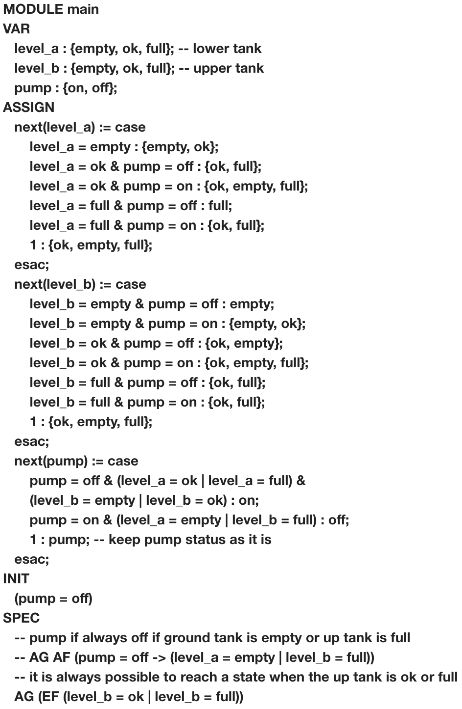
Model Checking Example
https://www.embedded.com/design/prototyping-and-development/4024929/An-introduction-to-model-checking
// Show counter example
// Example: (pump = off) -> AF (pump = on)

Slide 20
SMT Simple Verification Example
I am not sure about this one.. We should rather focus on model checking since it seems to be more understandable

Slide 21
Verification of Neural Networks
Adversarial examples
For example: https://arxiv.org/pdf/1707.08945.pdf
SMT, …

Slide 22
//Formal Verification and RL
Nasa paper
What can be verified? What different kind of learning (offline, online) and verification methods are there?
Specify what we want to verifiy / do?
“Model will always be in a non-dangerous state according to “

Slide 23
What can be verified?
Offline: validate after learning
State to Action: Verify that a certain action will not happen in a given state
Action sequences (via PRISM)
Algorithm properties (e.g. convergence to a fix point)
Assumptions on Training Data (variable ranges, …)
Online: validate during learning
State to Action
Action sequences
Monitoring

Slide 24
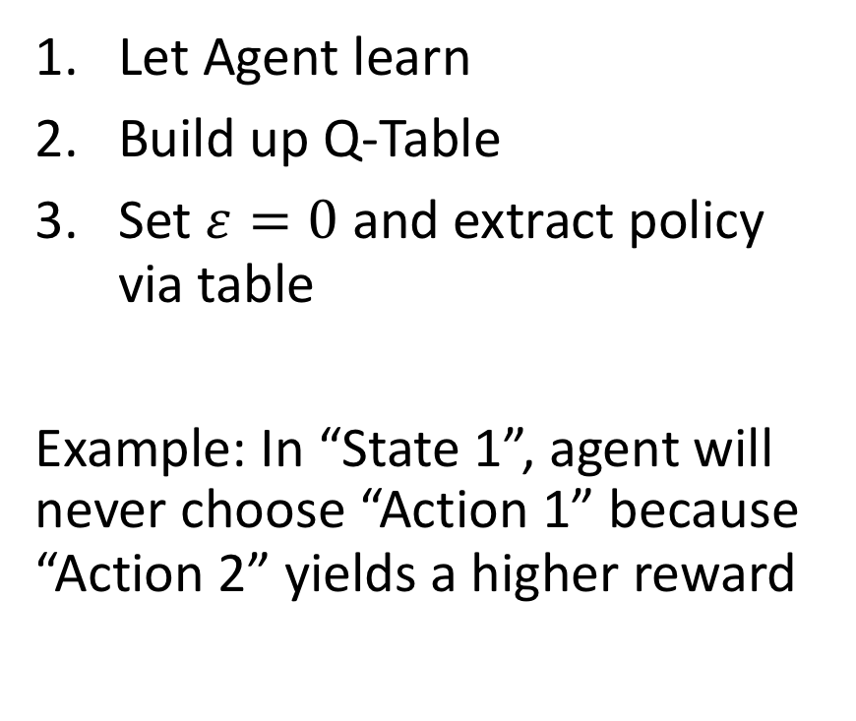
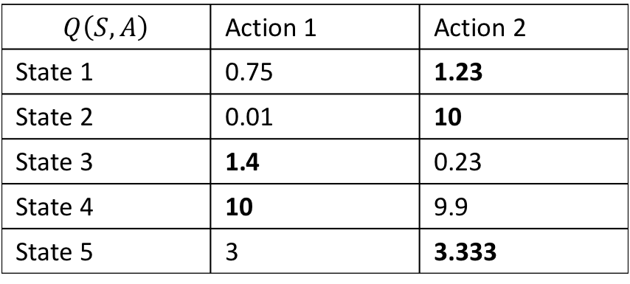
State to Action Verification in Q-Learning
$$Q\left(S, A\right)$$ | Action 1 | Action 2
State 1 | 0.75 | 1.23
State 2 | 0.01 | 10
State 3 | 1.4 | 0.23
State 4 | 10 | 9.9
State 5 | 3 | 3.333
Let Agent learn
Build up Q-Table
Set $ε=0$ and extract policy via table
Example: In “State 1”, agent will never choose “Action 1” because “Action 2” yields a higher reward

Slide 25
What about function approximation?
Usually: continuous states & function approximation via neural network
“How ‘much’ can I modify my state (e.g. a picture of a camera)” such that we still produce the same action
Solution: Reluplex: An Efficient SMT Solver for Verifying Deep Neural Networks

Slide 26
//describe RELUPLEX …

Slide 27
Action Sequences
PRISM

Slide 28
Model Checking: PRISM
One of the models that PRISM can check are “MDPs”
PRISM language is a variant of PCTL, LTL, and many more
Probabilistic reachability

Slide 29
Algorithm properties
Theorem on Q-Learning that converges

Slide 30
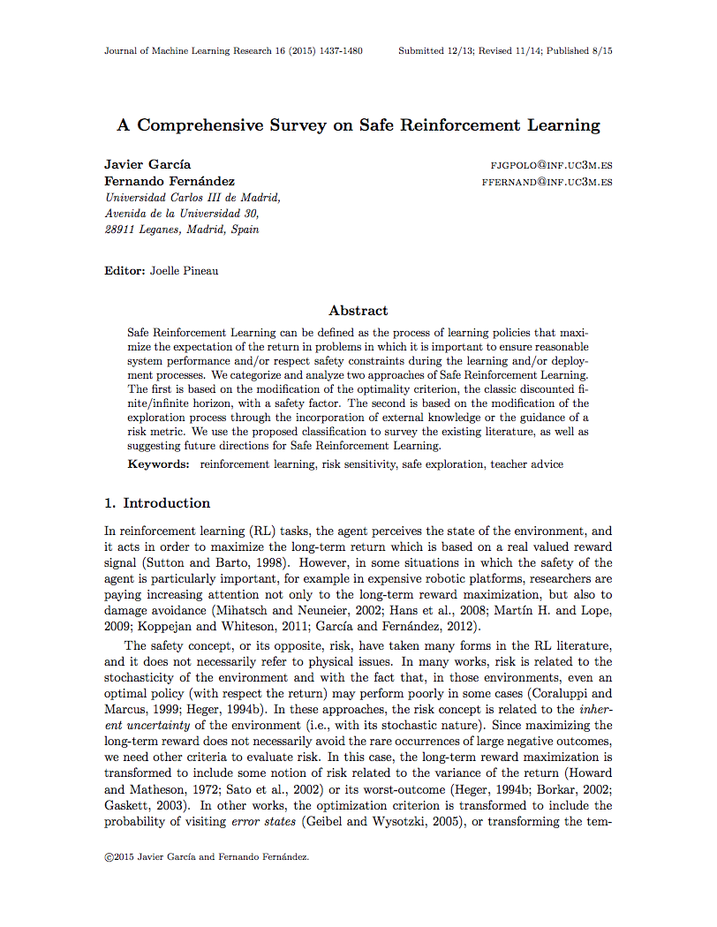
A Comprehensive Survey on Safe Reinforcement Learning (≤ 2015)
…

Slide 31
Lyapunov Functions

Slide 32
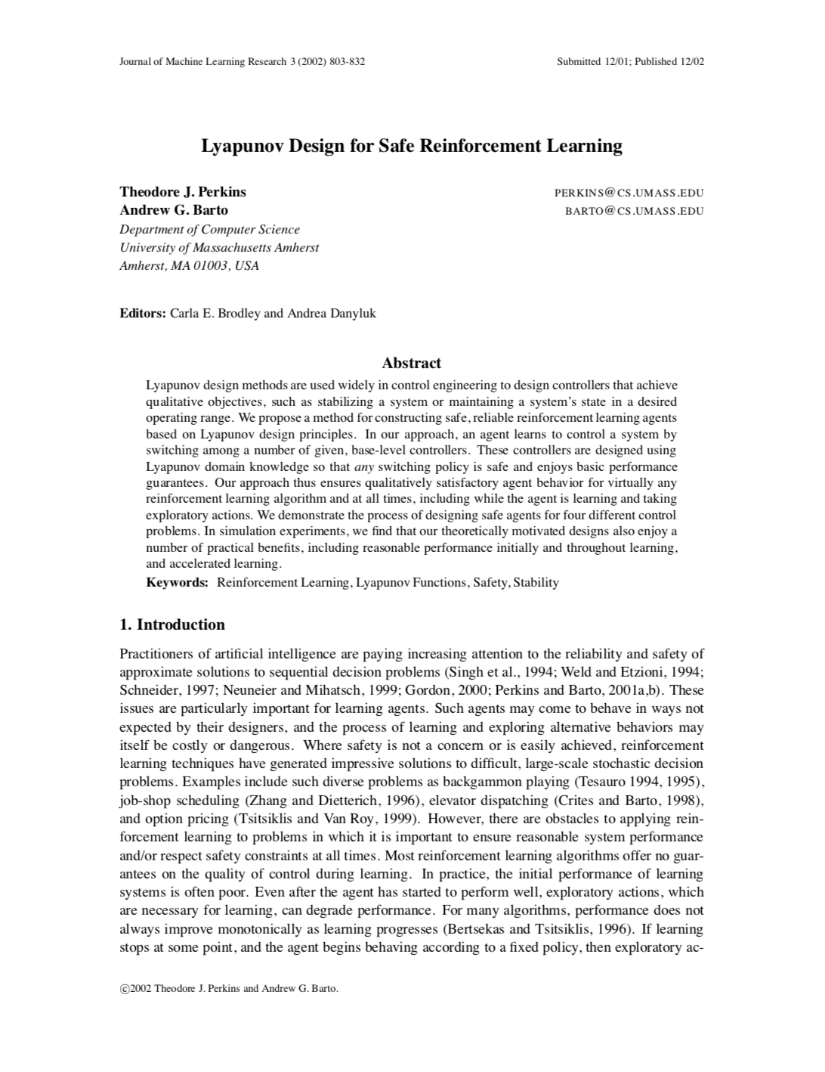
Lyapunov Design for Safe Reinforcement Learning (2002)
Optimal Control Problems
Works with any RL Algorithm
Idea: For a given problem, define actions that ensure any action will keep agent in safe state and moves it eventually there
Use RL to find a good combination of these actions
Problem: You need to come up with these actions by yourself

Slide 33
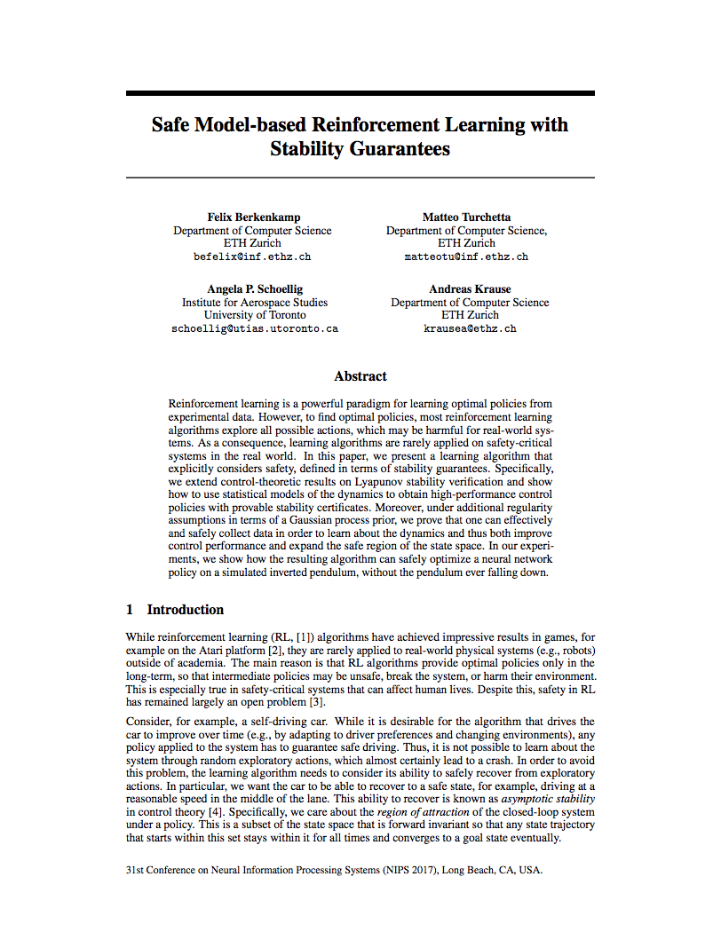
Safe Model-based Reinforcement Learning with Stability Guarantees (2017)
Main Idea: Be able to recover from every situation: “Asymptotic Stability”
Start with an initial, safe policy
Compute “region of attraction” via Lyapunov functions
Exploration will increase safe region and region of attraction

Slide 34
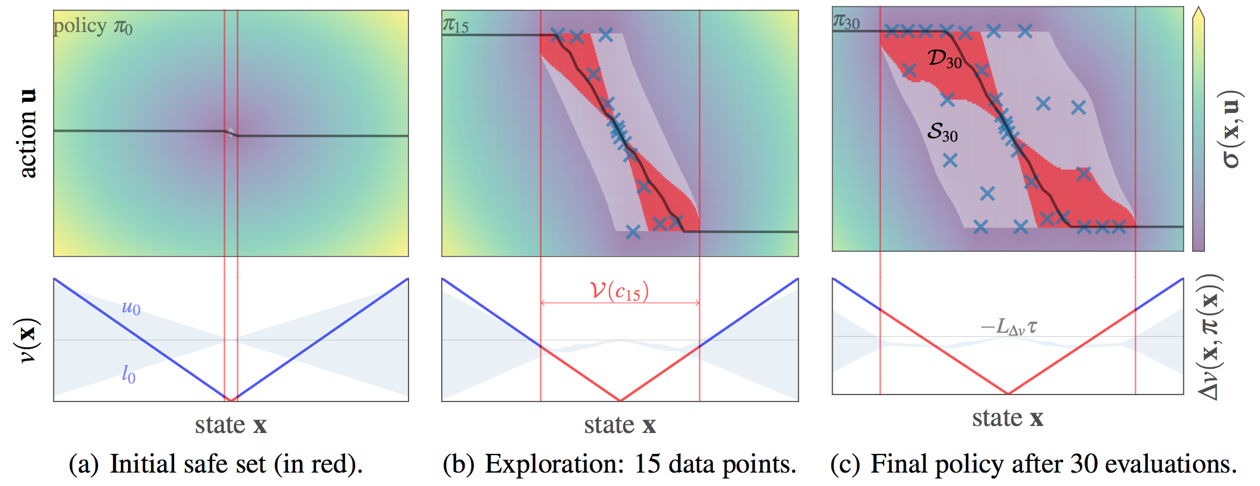
Region of Attraction

Slide 35
Problems
Safety in terms of probability. Probabilities can fail
Example: 99.999% it works, there are 1 000 000 drivers → it won’t stay safe for 10 drivers

Slide 36
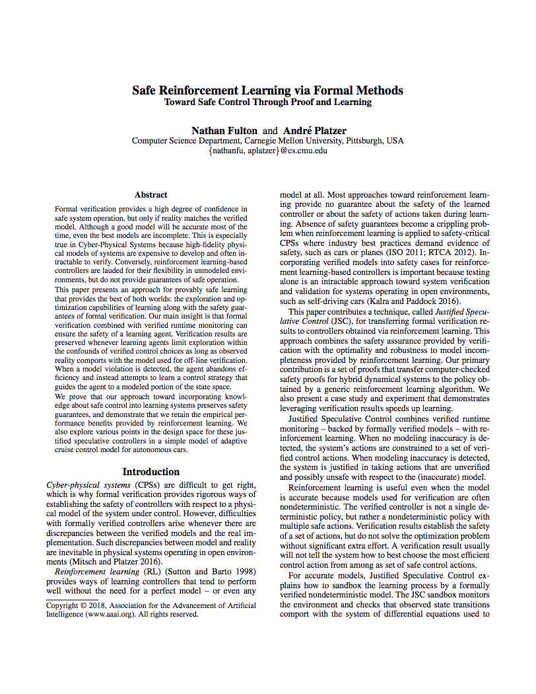
Safe Reinforcement Learning via Formal Methods (2018)
Model accurate: Choose safe action that maximizes reward
Model inaccurate: Choose any action that maximizes reward
Model Monitor: Is the model accurate?
Controller Monitor: Is an action safe?
Any safe action keeps the system safe

Slide 37
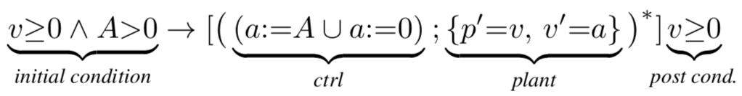
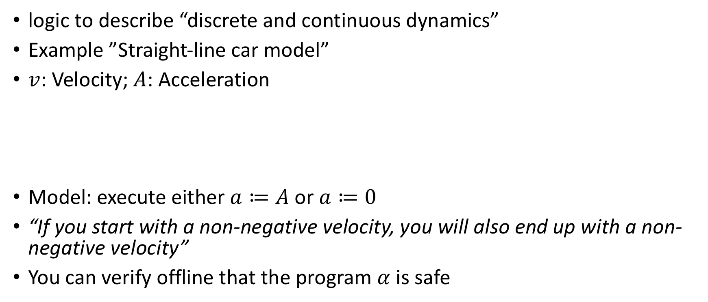
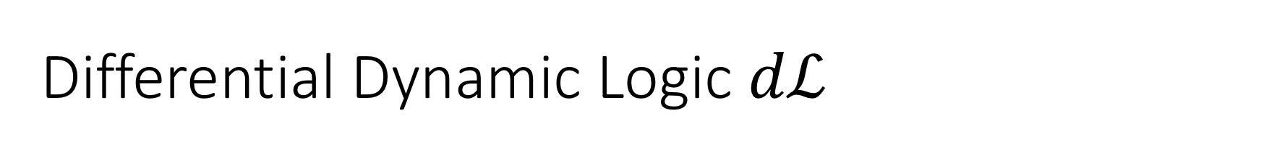
Differential Dynamic Logic $dℒ$
logic to describe “discrete and continuous dynamics”
Example ”Straight-line car model”
$v$: Velocity; $A$: Acceleration
Model: execute either $a≔A$ or $a≔0$
“If you start with a non-negative velocity, you will also end up with a non-negative velocity”
You can verify offline that the program $α$ is safe

Slide 38
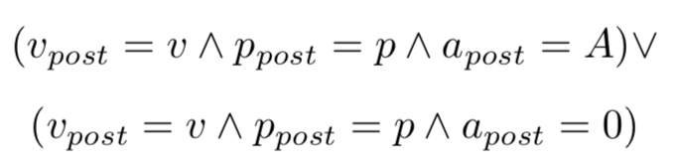
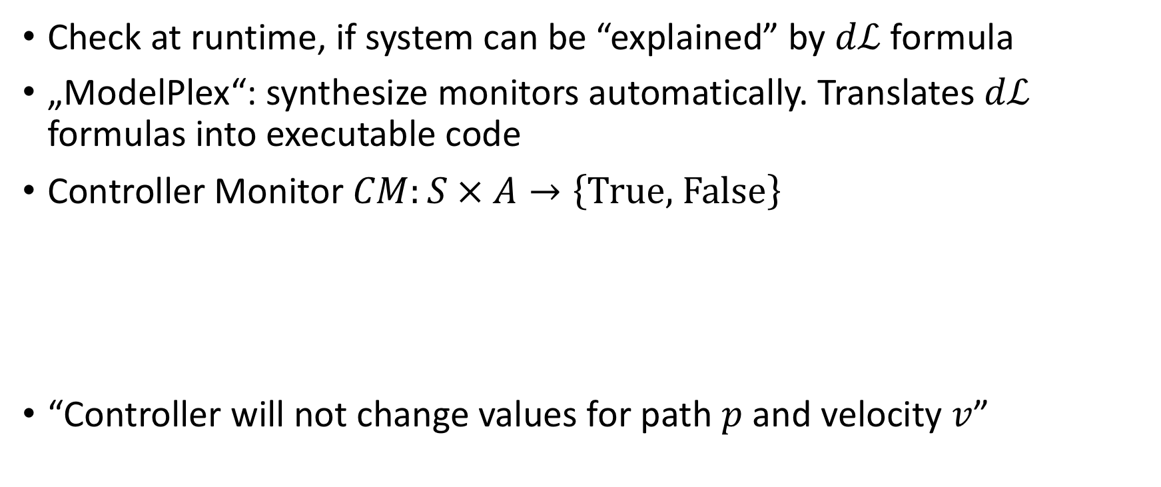
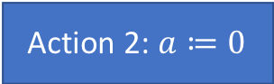
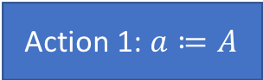
Controller Montor
Check at runtime, if system can be “explained” by $dℒ$ formula
„ModelPlex“: synthesize monitors automatically. Translates $dℒ$ formulas into executable code
Controller Monitor $CM:S × A→\left\{\text{True}\text{, }\text{False}\right\}$
“Controller will not change values for path $p$ and velocity $v$”
Action 1: $a≔A$
Action 2: $a≔0$

Slide 39
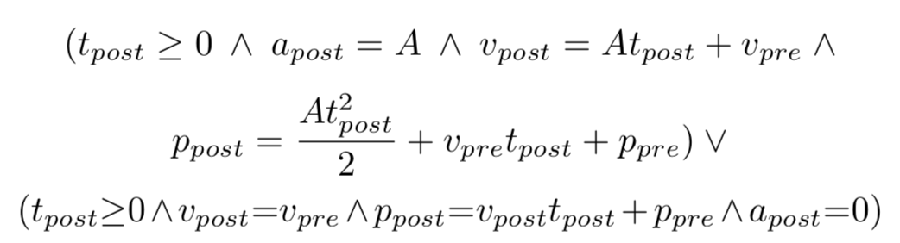
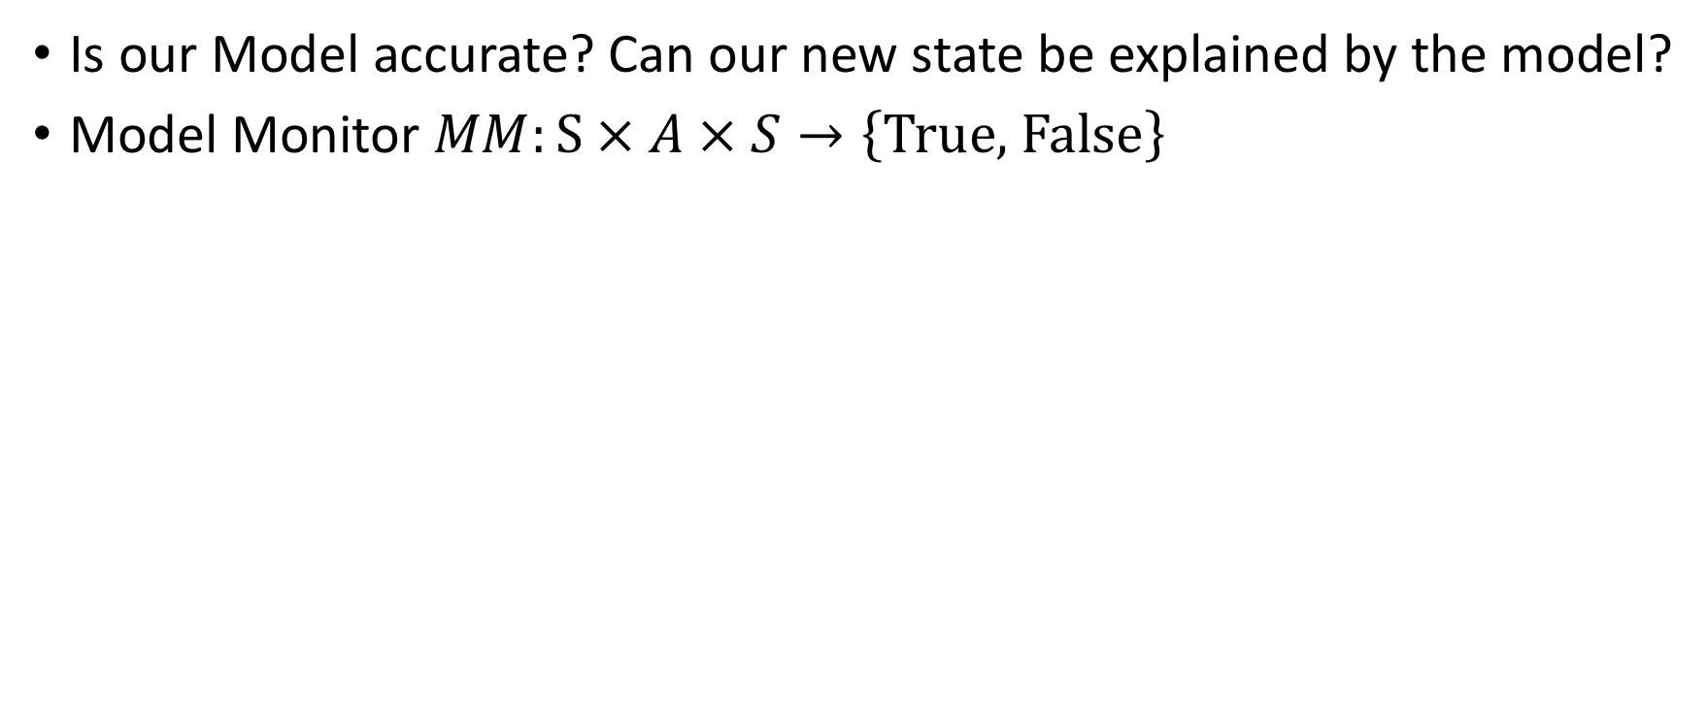

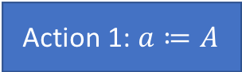
Model Monitor
Is our Model accurate? Can our new state be explained by the model?
Model Monitor $MM:S × A × S→\left\{\text{True}\text{, }\text{False}\right\}$
Action 1: $a≔A$
Action 2: $a≔0$

Slide 40
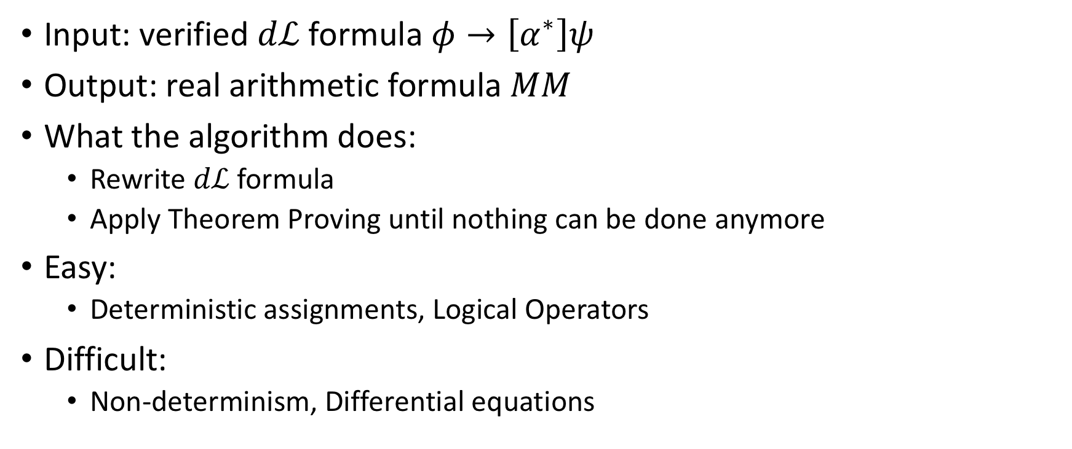
ModelPlex
Input: verified $dℒ$ formula $φ→\left[α^{∗}\right]ψ$
Output: real arithmetic formula $MM$
What the algorithm does:
Rewrite $dℒ$ formula
Apply Theorem Proving until nothing can be done anymore
Easy:
Deterministic assignments, Logical Operators
Difficult:
Non-determinism, Differential equations

Slide 41
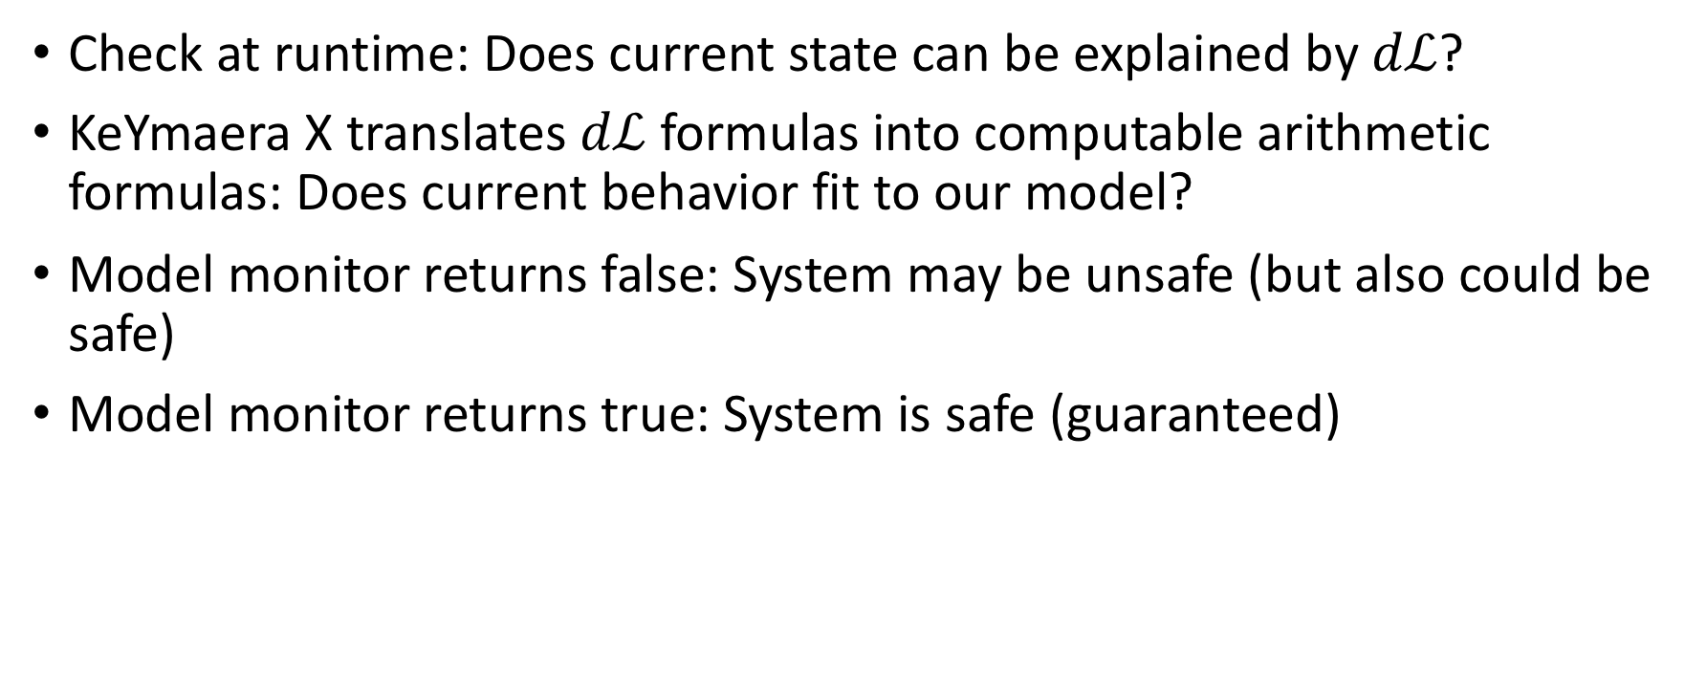
ModelPlex
Check at runtime: Does current state can be explained by $dℒ$?
KeYmaera X translates $dℒ$ formulas into computable arithmetic formulas: Does current behavior fit to our model?
Model monitor returns false: System may be unsafe (but also could be safe)
Model monitor returns true: System is safe (guaranteed)

Slide 42
Model might not reflect reality due to
Sensor errors
Mechanics malfunctions
Wrong (too simple) assumptions which do not hold in real life

Slide 43
Algorithm
JSCGeneric(init, (S,A,R,E), choose, update, done, CM, MM) {
prev := curr := init;
a0 := NOP;
while (!done(curr)) {
if (MM(prev, a0, curr))
u := choose({a ∈ A | CM(a,curr)});
else
u := choose(A);
prev := curr;
curr := E(u, prev);
update(prev, u, curr);
}
}

Slide 44
Example Adaptive Cruise Control

Slide 45
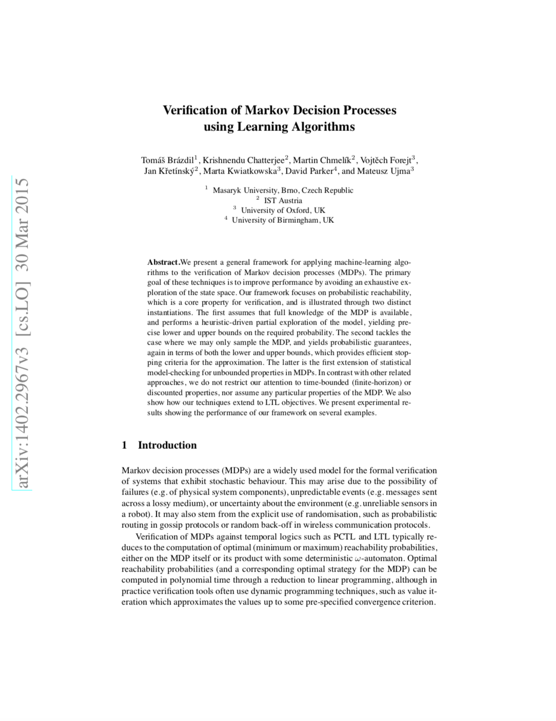
Verification of Markov Decision Processes using Learning Algorithms (2015)
?

Slide 46
DAGGER

Slide 47
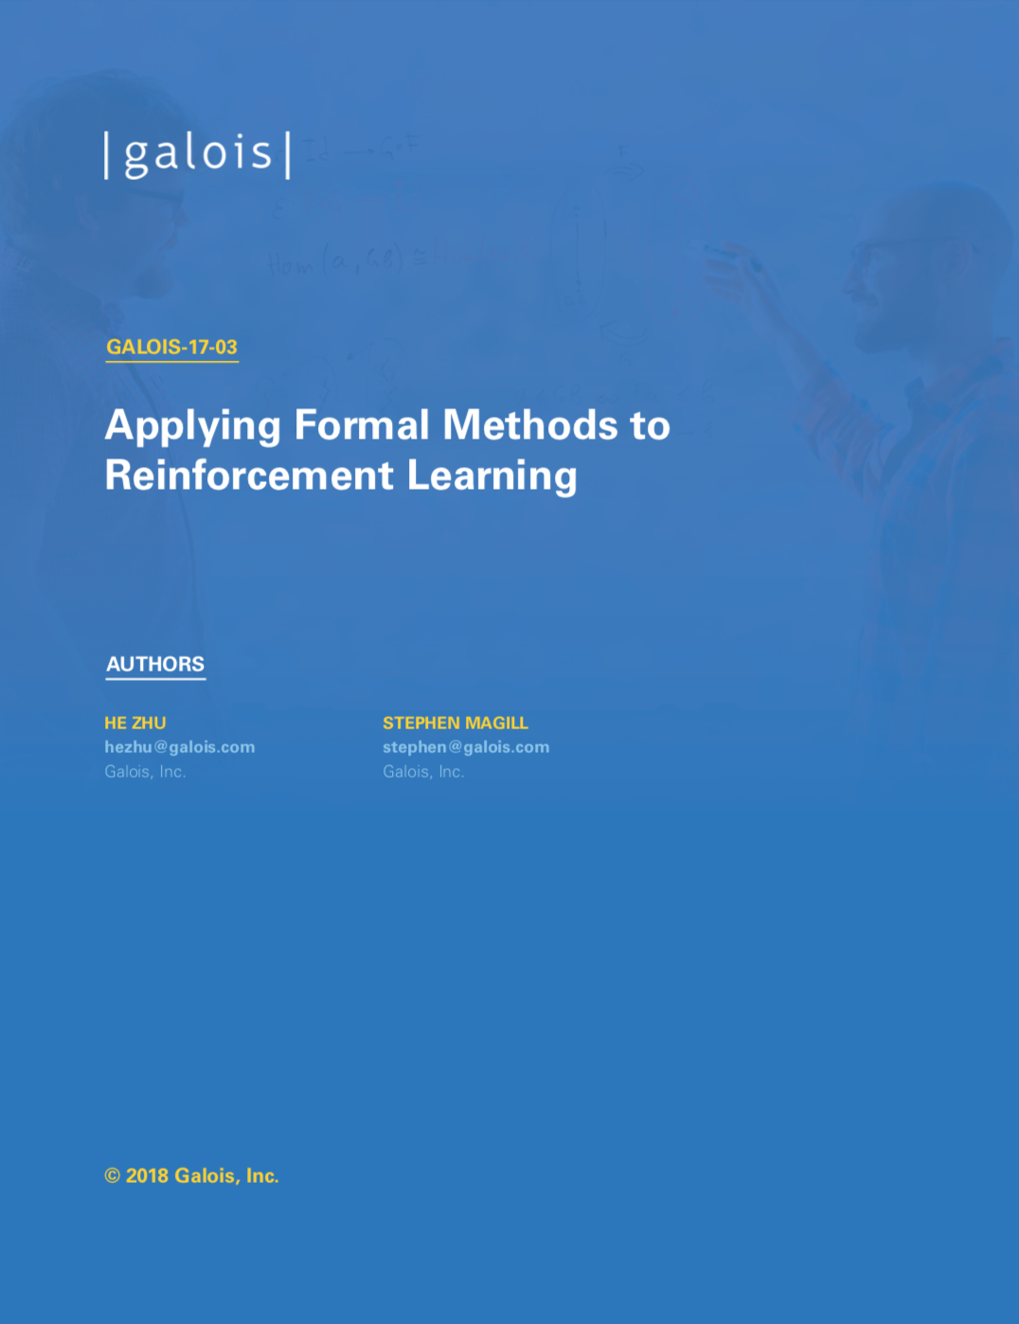
Applying Formal Methods to Reinforcement Learning (2018)
Learn from demonstrations
Problem 1: Agent may encounter unseen situations
Solution: Dataset-Aggregation
Problem 2: Generate “expert” trajectories automatically
Solution: Reward function synthesis using formal methods.

Slide 48
//Proposed Method
Name some ideas?
Advantages and disadvantages
Boost safe method with formal verification
Show that a certain approach does not work
...

Slide 49
//Formal Verification – The solution?
Conclusion, Research Direction, ...
Short discussion on the research questions
Why formal verification does not make driving 100% save

Slide 50
Open Questions and Problems
…

Slide 51
General Problems
Domain knowledge might be wrong
Model might not reflect reality
Constraints are hard to come up with
Probabilities
numeric errors → Verification of the implementation
Assumptions might be violated (or not considered!)
Continuity of dynamics, i.i.d., …

